Slide 1
CSI1241
CSI6203 Scripting Languages
Module 6
Functions

Slide 2
Contents
Introducing functions and abstraction
Function parameters
Returning values from function
Variable scope
Command Substitution

Slide 3
Learning Objectives
After finishing this module, you should be able to:
Understand and execute scripts that use multiple functions
Send information into functions and retrieve results from functions
Use command substitution to solve problems

Slide 4
Simple functions

Slide 5
Functions
Functions are blocks of code that can be run at any time.
In bash, a function is similar to a script but instead of being saved into a file, it is stored in memory.
Functions are useful at breaking scripts up into neat logical modules and reducing the need for repeated code.

Slide 6
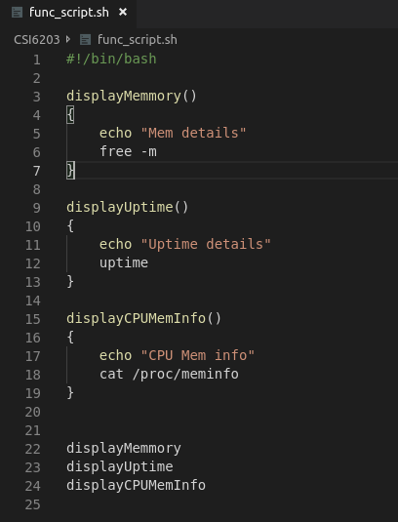
Functions
Functions can be created outside of scripts by typing the function code into the bash command line
(The uptime command shows how long the computer has been on)

Slide 7
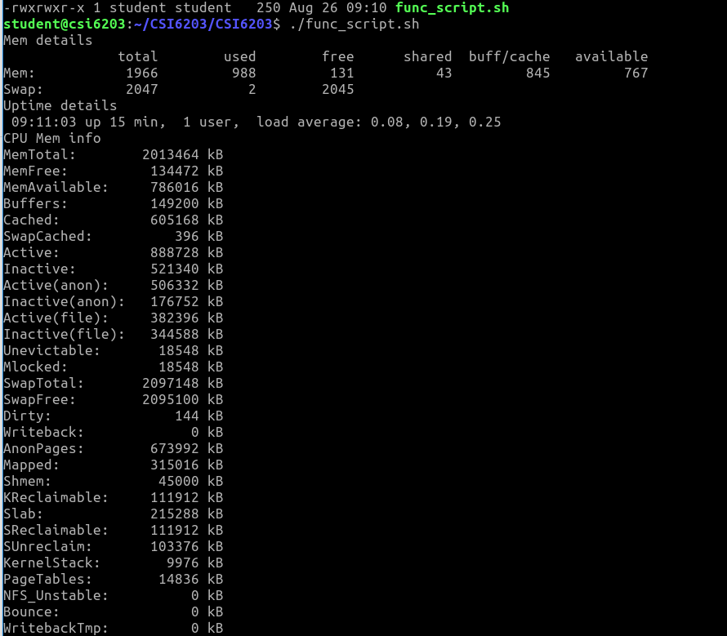
Functions
To execute a function from the command line, type the name of the function (similar to running a script).

Slide 8
Functions
Functions can be created inside of scripts to allow for easy code re-use.
Instead of needing to copy-paste large sections of scripts, functions can allow the code to be executed by name

Slide 9
#!/bin/bash
colour_green()
{
echo -e -n "Green Text: \033[32m"
}
colour_reset()
{
echo -n -e "\033[0m"
}
echo "this is some normal text"
colour_green
echo "this is some green text"
colour_reset
echo "back to normal"

Slide 10
#!/bin/bash
colour_green()
{
echo -e -n "Green Text: \033[32m"
}
colour_reset()
{
echo -n -e "\033[0m"
}
echo "this is some normal text"
colour_green
echo "this is some green text"
colour_reset
echo "back to normal"
Create the function for later use

Slide 11
#!/bin/bash
colour_green()
{
echo -e -n "Green Text: \033[32m"
}
colour_reset()
{
echo -n -e "\033[0m"
}
echo "this is some normal text"
colour_green
echo "this is some green text"
colour_reset
echo "back to normal"
Create the function for later use

Slide 12
#!/bin/bash
colour_green()
{
echo -e -n "Green Text: \033[32m"
}
colour_reset()
{
echo -n -e "\033[0m"
}
echo "this is some normal text"
colour_green
echo "this is some green text"
colour_reset
echo "back to normal"
Print text

Slide 13
#!/bin/bash
colour_green()
{
echo -e -n "Green Text: \033[32m"
}
colour_reset()
{
echo -n -e "\033[0m"
}
echo "this is some normal text"
colour_green
echo "this is some green text"
colour_reset
echo "back to normal"
Execute the “colour_green” function

Slide 14
#!/bin/bash
colour_green()
{
echo -e -n "Green Text: \033[32m"
}
colour_reset()
{
echo -n -e "\033[0m"
}
echo "this is some normal text"
colour_green
echo "this is some green text"
colour_reset
echo "back to normal"
Print green colour code

Slide 15
#!/bin/bash
colour_green()
{
echo -e -n "Green Text: \033[32m"
}
colour_reset()
{
echo -n -e "\033[0m"
}
echo "this is some normal text"
colour_green
echo "this is some green text"
colour_reset
echo "back to normal"
Print text

Slide 16
#!/bin/bash
colour_green()
{
echo -e -n "Green Text: \033[32m"
}
colour_reset()
{
echo -n -e "\033[0m"
}
echo "this is some normal text"
colour_green
echo "this is some green text"
colour_reset
echo "back to normal"
Execute the “colour_reset” function

Slide 17
#!/bin/bash
colour_green()
{
echo -e -n "Green Text: \033[32m"
}
colour_reset()
{
echo -n -e "\033[0m"
}
echo "this is some normal text"
colour_green
echo "this is some green text"
colour_reset
echo "back to normal"
Print reset colour code

Slide 18
Output
this is some normal text
Green Text: this is some green text
back to normal

Slide 19
Function Arguments

Slide 20
Function Arguments
Functions can have arguments, just like scripts.
The $1, $2 etc. variables work the same way as they do in scripts

Slide 21
Function Arguments
#!/bin/bash
greet_name()
{
echo "Hello $1"
}
greet_name "Geoff"
greet_name "Sally"
greet_name "Control"

Slide 22
Function Arguments
Output:
In many ways, functions can act as scripts within scripts
Hello Geoff
Hello Sally
Hello Control

Slide 23
A more complex example
#!/bin/bash
greet_name()
{
echo "Hello $1"
}
while true
do
read -p "please type your name or q to quit: "
if [ "$REPLY" = "q" ] ; then
break;
else
greet_name "$REPLY"
fi
done
echo "Goodbye!"
exit 0

Slide 24
Output

Slide 25
Scope and Return Values

Slide 26
Variable Scope
“Scope” refers to the parts of code where a variable can be used
A variable used before it has a value is considered to be “out of scope”

Slide 27
Variable Scope
By default, variables are stored globally
This means any variable created in a function can be used anywhere in the script
This can lead to problems with large scripts that use the same variable name for different things

Slide 28
Variable Scope
#!/bin/bash
func()
{
word="Toast"
}
word="Test"
echo $word
func
echo $word
The “word” variable here can be changed by the function, even if that is not intended behaviour

Slide 29
Output
The “word” variable here can be changed by the function, even if that is not intended behaviour
Test
Toast

Slide 30
Variable Scope
A better option is to use local variables inside functions.
A local variable will only exist within the function and will go out of scope as soon as the function is finished

Slide 31
Variable Scope
#!/bin/bash
func()
{
local word="Toast"
}
word="Test"
echo $word
func
echo $word
The “word” variable in func only exists inside the function. It is not the same as the one outside

Slide 32
Output
The “word” variable here cannot be changed by the function. This lets the same variable name to be reused in multiple places
Test
Test

Slide 33
Return values
Often functions will have local variables and echo the results to send data back to the script
This allows functions to be treated like mathematical functions which have a single result
This is done by using command substitution

Slide 34
Return values
calculate_volume()
{
local volume=$(( $1*$2*$3 ))
echo $volume
}
#command substitution
swimmingPool=$(calculate_volume 3 5 10)
echo "The volume of the pool is: $swimmingPool"
bedroom=$(calculate_volume 5 6 12)
echo "The volume of the bedroom is: $bedroom"

Slide 35
Command Substitution
Command Substitution allows the output of a command or function will be stored in variables instead of printed to the screen
swimmingPool=$(calculate_volume 3 5 10)

Slide 36
Output
The volume of the pool is: 150
The volume of the bedroom is: 360

Slide 37
Return values
Bash does have a “return” command similar to other languages.
However, the return command sets the “exit_status” of the function, so it can only return numeric values and can be accessed using $?

Slide 38
Return values
calculate_volume()
{
local volume=$(( $1*$2*$3 ))
return $volume
}
#using return
calculate_volume 3 5 10
echo "The volume of the pool is: $?"
calculate_volume 5 6 12
echo "The volume of the bedroom is: $?"

Slide 39
Summary
Terms to review and know include:
Functions
abstraction
Function parameters/arguments
Variable scope
Command Substitution
Return

Slide 40
References and Further Reading
Ebrahim, M. and Mallet, A. (2018) Mastering Linux Based Scripting (2nd Ed) Chapter 7, pp 125-140
http://tldp.org/LDP/abs/html/functions.html
http://tldp.org/HOWTO/Bash-Prog-Intro-HOWTO-8.html
https://likegeeks.com/bash-functions

